Slide 1
Mudassir
Roll No : 25F-CY-066
Topic : biot-Savart Law

Slide 2
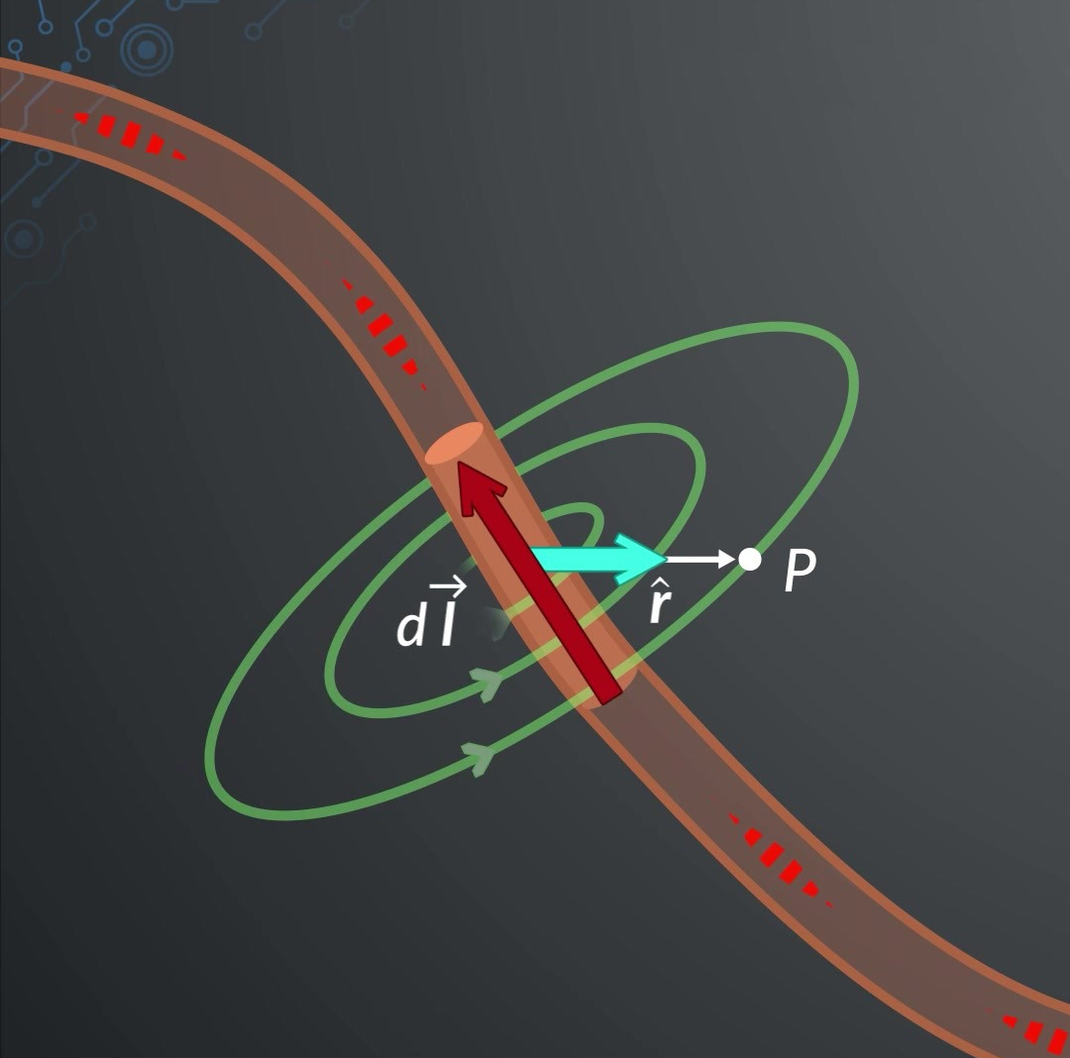
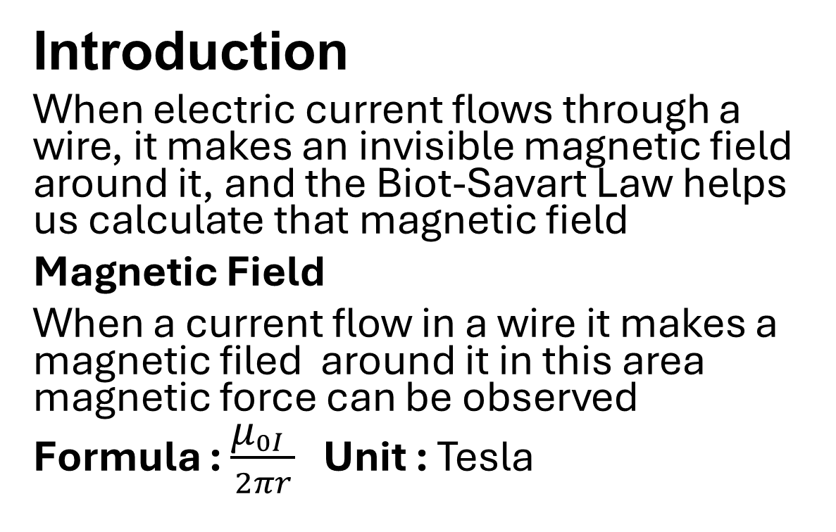
Biot-Savart Law
Introduction
When electric current flows through a wire, it makes an invisible magnetic field around it, and the Biot-Savart Law helps us calculate that magnetic field
Magnetic Field
When a current flow in a wire it makes a magnetic filed around it in this area magnetic force can be observed
Formula : $\frac{{\text{μ}}_{0I} }{2πr}$ Unit : Tesla

Slide 3

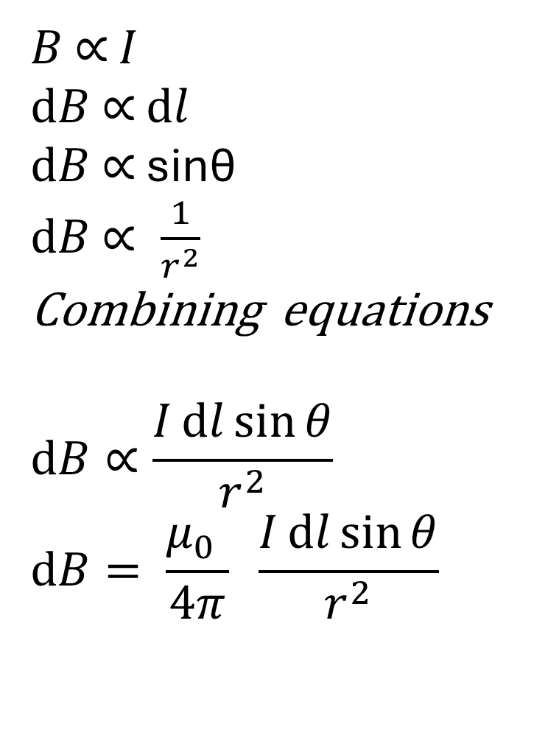







Derivation ( Formula Form )
$B$ ∝ $I$
$ⅆB$ ∝ $ⅆl$
$ⅆB$ ∝ sinθ
$ⅆB$ $∝ \frac{1}{r^{2}}$
Combining equations
$$ⅆB∝\frac{Iⅆl\sin{θ}}{r^{2}}$$
$$ⅆB= \frac{{\text{μ}}_{0} }{4π} \frac{Iⅆl\sin{θ}}{r^{2}}$$
$$p$$
$$ⅆ\vec{B}$$
$$\vec{r}$$
$$B$$
$$θ$$
$$d\vec{l}$$
$$A$$
$$C$$
(For magnitude )
$$I$$

Slide 4
Biot–Savart law depending factors
Current (I): More current → stronger magnetic field
Length of wire (dl) : Bigger wire part → more magnetic field.
Distance (r) : Farther from wire → weaker magnetic field
Angle (θ) : Magnetic field changes with the angle between wire and the point
Medium (μ₀) : The type of material around the wire (like air or iron) affects the magnetic field.

Slide 5
Daily life Applications
Electric Motors and Generator
The Biot-Savart law helps calculate the magnetic field produced by current-carrying wires in motors and generators.
MRI Machines (Medical Use)
MRI scanners use strong magnetic fields calculated using the Biot-Savart law to produce detailed images of body organs.
Magnetic Field in Electric Circuits
Used to find the magnetic field around wires, coils, and solenoids in household appliances like fans, speakers, and transformers.

